Slide 1
Disaster Recovery with Azure Kubernetes Service
Subtitle or speaker name

Slide 2
Agenda
Node availability
Multi-region deployments
Network-close images

Slide 3
Node availability

Slide 4
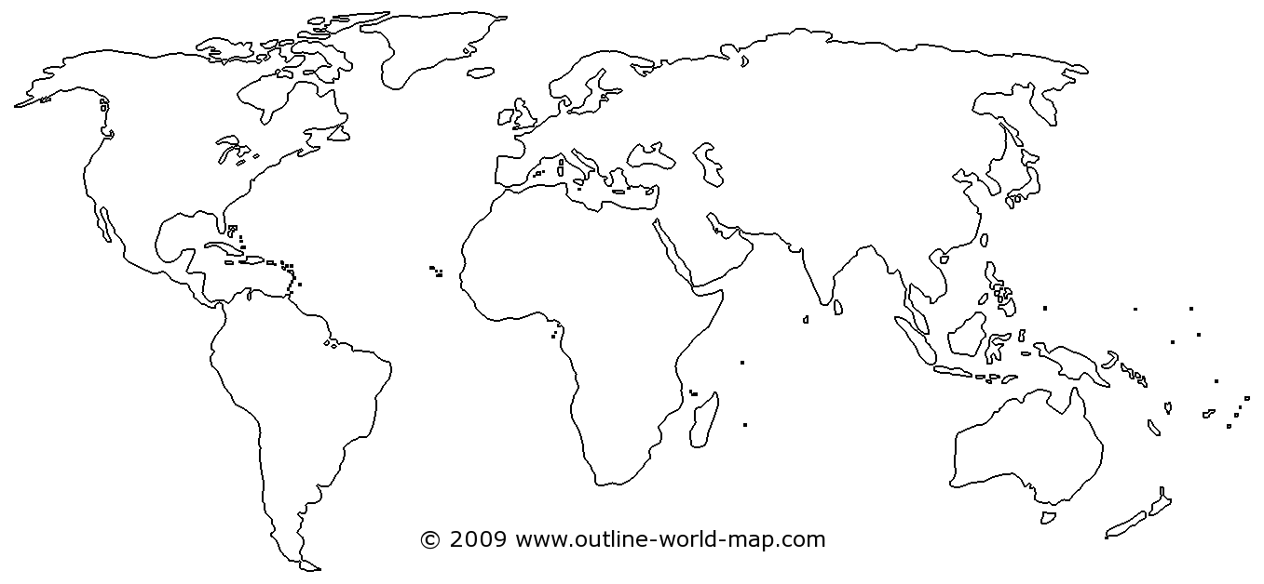
Availability Zones
Region*
AKS AZs
Region*
AKS AZs
Region*
AKS AZs
Notes:
As you know, zones offer protection from datacenter failures in region by deploying resources to unique physical locations within region. Each zone is made up of one or more datacenters equipped with independent power, cooling, and networking. To ensure resiliency, there's a minimum of three separate zones in all zone enabled regions.
AKS distributes your resources such as nodes and their associated storage through the Azure fabric using Virtual Machine Scale Sets and being that AKS is built on top of virtual machines we can take advantage of features such as Availability Zones. The introduction of availability zone support for AKS allows you to distribute your cluster nodes across 1 or more availability zones at the time a cluster is created.
When you create a cluster using the az aks create command, the --zones parameter defines which zones agent nodes are deployed into. The control plane components such as etcd is spread across three zones if you define the --zones parameter at cluster creation time. The specific zones which the control plane components are spread across are independent of what explicit zones are selected for the initial node pool. If you don't define any zones for the default agent pool when you create an AKS cluster, control plane components are not guaranteed to spread across availability zones. You can add additional node pools using the az aks nodepool add command and specify --zones for new nodes, but it will not change how the control plane has been spread across zones.
Another advantage of Availability Zones beyond raw resiliency is for customers who have purchased an Azure Kubernetes Service (AKS) Uptime SLA, Azure guarantees uptime of 99.95% for the Kubernetes API Server for AKS Clusters that use Azure Availability Zones vs 99.9% for AKS Clusters that do not use Azure Availability Zones.

Slide 5
Deploying AKS components with AZs
az group create --name clusterRG --location eastus2
# Create a cluster with zonal support
az aks create \
--resource-group clusterRG \
--name aksCluster \
--generate-ssh-keys \
--vm-set-type VirtualMachineScaleSets \
--load-balancer-sku standard \
--node-count 7 \
--zones 1 2 3
az aks nodepool add \
--cluster-name aksCluster
--name zonalpool
--resource-group clusterRG
--mode User
--node-count 2
--zones 1 3
Notes:
Walk through the two examples…
When deciding what zone a new node should belong to, a given AKS node pool will use a best effort zone balancing offered by underlying Azure Virtual Machine Scale Sets. A given AKS node pool is considered "balanced" if each zone has the same number of VMs or +- 1 VM in all other zones for the scale set.
With best-effort zone balance, the scale set attempts to scale in and out while maintaining balance. However, if for some reason this is not possible (for example, if one zone goes down, the scale set cannot create a new VM in that zone), the scale set allows temporary imbalance to successfully scale in or out. On subsequent scale-out attempts, the scale set adds VMs to zones that need more VMs for the scale set to be balanced. Similarly, on subsequent scale in attempts, the scale set removes VMs from zones that need fewer VMs for the scale set to be balanced.

Slide 6
Limitations
Regions
Limited regional support
VM SKU
Must be available across all zones selected
Load balancers
Disks
Stateful applications?
YANC…
Notes:
There are limitations to Availability Zones in AKS that you should be aware of.
The first is limited regional support. As of today, the ability to deploy an AKS cluster with zonal support is not available in all of the regions where AKS is available, even if that region supports zones. You should refer to the docs for the most up to date information, but for today, AKS w/ zones is limited to:
Central US
East US 2
East US
France Central
Japan East
North Europe
Southeast Asia
UK South
West Europe
West US 2
Next up, be aware that the VM SKU you select for use in your cluster or pool nodes needs to be available in all zones. It doesn't often happen that this isn't the case, but if you're using a specialized VM series it is something to watch out for.
Clusters with availability zones enabled also require the use of Azure Standard Load Balancers for distribution across zones. This load balancer type is the default and can only be defined at cluster create time.
Azure managed disks are also not zone-redundant resources. Volumes cannot be attached across zones and must be co-located in the same zone as a given node hosting the target pod created from your spec. If you are deploying stateful applications, use node pool taints and tolerations in pod specs to group pod scheduling in the same zone as your disks. Alternatively, you can use network-based storage such as Azure Files that can attach to pods as they're scheduled between zones.
And remember YANC, or Yet Another New Cluster – zones, VM scale sets, standard balancers, etc. all require the creation of a new cluster and cannot be enabled in existing clusters.

Slide 7
Demo
Verifying node distribution

Slide 8
Multi-region deployments

Slide 9
Routing
Traffic Manager
Azure Front Door Service

Slide 10
Persistent storage
Managed disks
Storage replication

Slide 11
Network-close images

Slide 12
ACR geo-replication

Slide 13
Thank you.

Slide 14
Easy to modify 4 column table
Table header | Table header | Table header | Table header
To modify table, first click anywhere in table, so the Table Tools menu is highlighted at top | Layout > To add rows, click into cell and choose, Insert Above or Insert Below | Layout > Shrink or expand column widths by adjusting the Cell Size, or set them to same size with Distribute
To modify the table layout, click Table Tools > Layout To modify the table layout, click Table Tools > Design | Layout > To add rows, click into cell and choose, Insert Left or Insert Right | Layout > Use Alignment settings to adjust text alignment and cell margins | Tip: To quickly add a row, place cursor in this last cell and hit the Tab key

Slide 15
Additional table
 | Header 1 | Header 2 | Header 3 | Header 4 | Header 5 | Header 6
Row 1 | – | – | – | – | – | –
Row 2 | – | – | – | – | – | –
Row 3 | – | – | – | – | – | –
Row 4 | – | – | – | – | – | –

